Slide 1


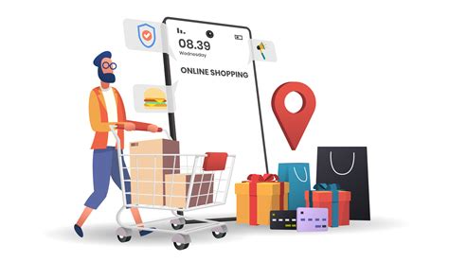

Intelligent Online Shopping
Discover how machine learning can revolutionize your online shopping experience. From personalized recommendations to streamlined checkout, this presentation explores the cutting-edge technologies that are transforming the way we shop.

Slide 2

Challenges in Traditional Shopping Carts
1
Impersonal Recommendations
2
Complicated Checkout
3
Limited Insights
Lengthy forms and multiple steps can lead to abandoned carts.
Lack of customer data hinders the ability to optimize the shopping experience.
Generic product suggestions fail to meet individual needs and preferences.

Slide 3
Blockchain for Secure Transactions
Decentralized Security
Transparent Traceability
Efficient Micropayments
Blockchain's distributed ledger ensures the integrity of every transaction, protecting your sensitive information.
The immutable nature of blockchain records allows you to track the entire history of your purchases.
Blockchain-based micropayments enable seamless, low-cost transactions for even the smallest purchases.

Slide 4
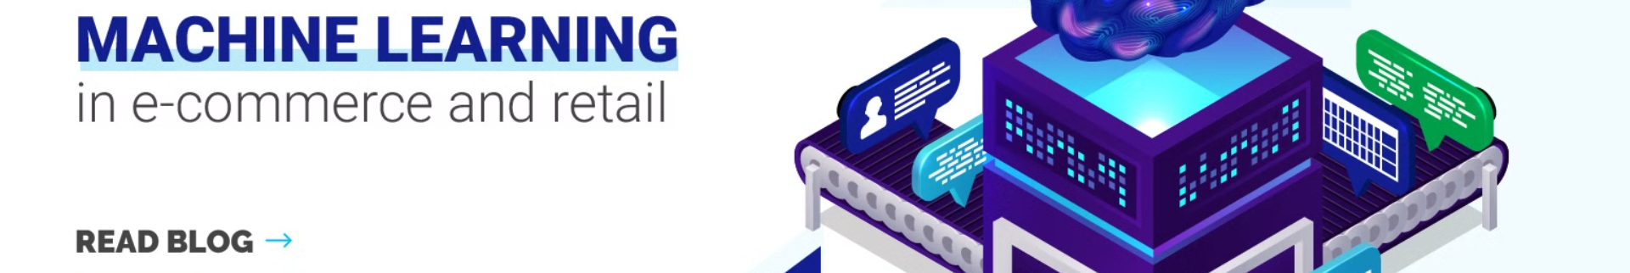
Machine Learning Recommendations
User Profiling
Personalized Curation
Analyze customer browsing and purchase history to build comprehensive user profiles.
Dynamically curate a unique shopping experience for each customer based on their interests and behaviors.
1
2
3
Predictive Analytics
Apply machine learning algorithms to predict user preferences and suggest relevant products.

Slide 5


Secure Identity Management
Biometric Authentication
Leverage advanced biometrics, such as fingerprint or facial recognition, to securely verify customer identities.
Distributed Identity Wallets
Empower customers to manage their own digital identities, reducing the risk of centralized data breaches.
Consent-based Access
Give customers control over their personal data, allowing them to grant or revoke access as needed.

Slide 6


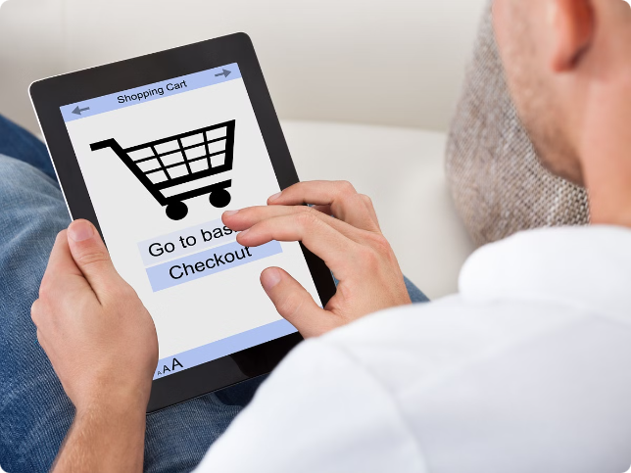


Intelligent Checkout Process
Smart Form Autofill
Leverage customer data to automatically populate checkout forms, reducing friction and cart abandonment.
One-Click Payments
Implement secure, streamlined payment options that allow customers to complete transactions with a single click.
Intelligent Cross-selling
Suggest complementary products during checkout, enhancing the customer's shopping experience and increasing order value.

Slide 7


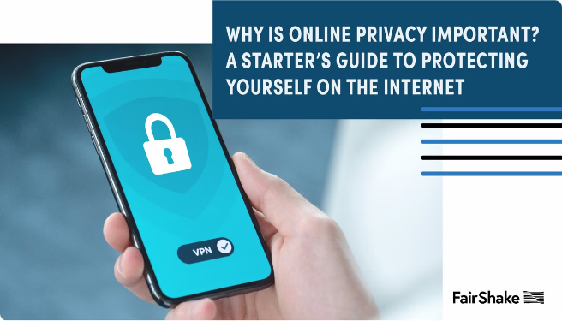


Preserving Privacy
Encrypted Data
Safeguard customer information with advanced encryption techniques to ensure privacy and security.
Anonymized Profiles
Create anonymized user profiles to protect individual identities while still leveraging data insights.
Consent-driven Data Use
Empower customers to control the use of their data, ensuring transparency and building trust.

Slide 8

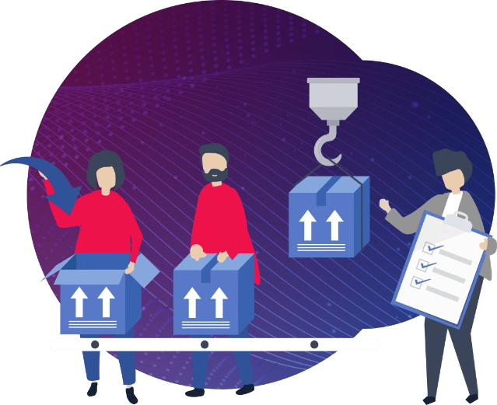
Scalability and Efficiency
Distributed Infrastructure
Decentralized systems can handle high traffic and transaction volumes without performance degradation.
Automated Scaling
Intelligent algorithms dynamically adjust resources to meet fluctuating customer demands.
Energy-efficient Design
Advanced technologies and optimized processes minimize the environmental impact of the shopping platform.

Slide 9
Applications and Use Cases
Retail
Digital Marketplaces
Subscription Services
Seamless online shopping experiences for a wide range of consumer goods and services.
Peer-to-peer trading platforms for unique, handcrafted, or specialty items.
Personalized recommendations and frictionless checkout for recurring digital or physical goods.

Slide 10


The Future of Online Shopping
1
Immersive Experiences
Explore and interact with products in virtual or augmented reality environments.
2
Autonomous Fulfillment
Autonomous drones and vehicles deliver purchases directly to customers' doorsteps.
3
Continuous Innovation
Ongoing advancements in AI, blockchain, and other technologies will further enhance the online shopping experience.

